Slide 1









Mentor Training Lifelong Learning

Slide 2
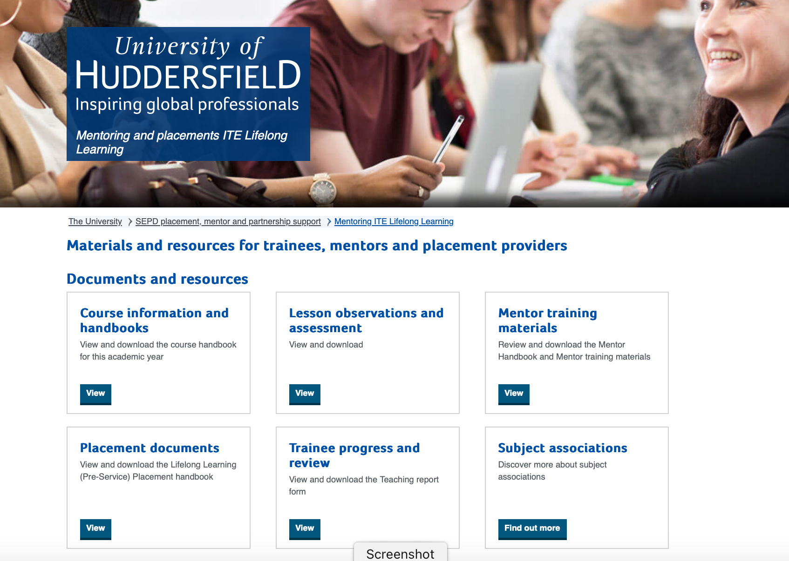
Overview of the session
Introductions
ITE mission statement and the three strands
Outline of the in-service and pre-service courses and the curriculum
Teaching practice requirements
  General issues
  Role of the mentor
  Observations and assessment
  Documentation
  Link to the mentoring materials:
  Mentoring ITE Lifelong Learning - University of Huddersfield
Questions

Slide 3
Our mission for ITE
Our mission is:
To develop professional educators whose purpose is to transform the learning and life opportunities of the children, young people and adults with whom they work. Through inclusive practice, reflection and commitment to continuous personal development, our trainees are empowered to become autonomous practitioners who enable all learners to realise their potential.
We develop teachers who:
Have a holistic understanding of the role of a teacher both within and beyond the classroom, and a strong moral purpose for teaching
Use inclusive teaching approaches and philosophies
Use evidence-informed pedagogy
Have strong subject & curriculum knowledge and see their professional learning as a continuous journey beyond their initial training
Apply reflective and critical thinking to their teaching
Are effective and engaging practitioners
Become autonomous, confident professionals who are able to make
informed decisions in collaboration with other stakeholders

Slide 4
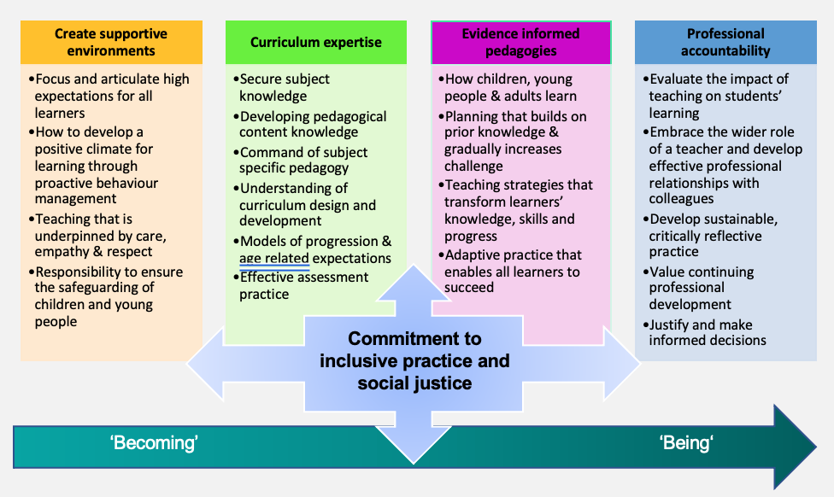
The becoming to being trajectory

Slide 5
Warmer
In the chatstream, please record the following:
what you are certain of regarding your role as a mentor
what you would like more information on
We will return to these points during the session.
Also, please identify any benefits to being a mentor.

Slide 6
Benefits of being a mentor
Mentees add value to the organisation by participating in all aspects of practical pedagogical training, including diagnostic assessment, learning design, research-based teaching, in-class support, cover supervision and team-teaching.
Mentees can also share theoretical knowledge and aspects of current pedagogy with their mentors and the teaching team based on their recent academic experience.
Mentoring can also maximise your own professional competencies and contribute to your professional development.

Slide 7
Information about the course
In Service. Pre Service
Certificate in Education (Cert Ed)
Professional Graduate Certificate in Education (PGCE)
Post Graduate Certificate in Education (PGCE)
Post Graduate Diploma in Education (PGDipE)
2 Year PT
1 Year FT
Level 5
Level 6
Modules 3 & 4 Level 7
Level 7

Slide 8
Curriculum changes from September 2024
From September 2024 our full-time Pre-service, Year 1 part-time Pre-service and Year 1 In-service trainees will follow an updated and revised curriculum.
Year 2 part-time Pre-service and Year 2 In-service trainees will remain on the previous curriculum during the 24-25 academic year.
For the 24-25 year we, therefore, be working with two curricula and this is reflected in the following slides.

Slide 9
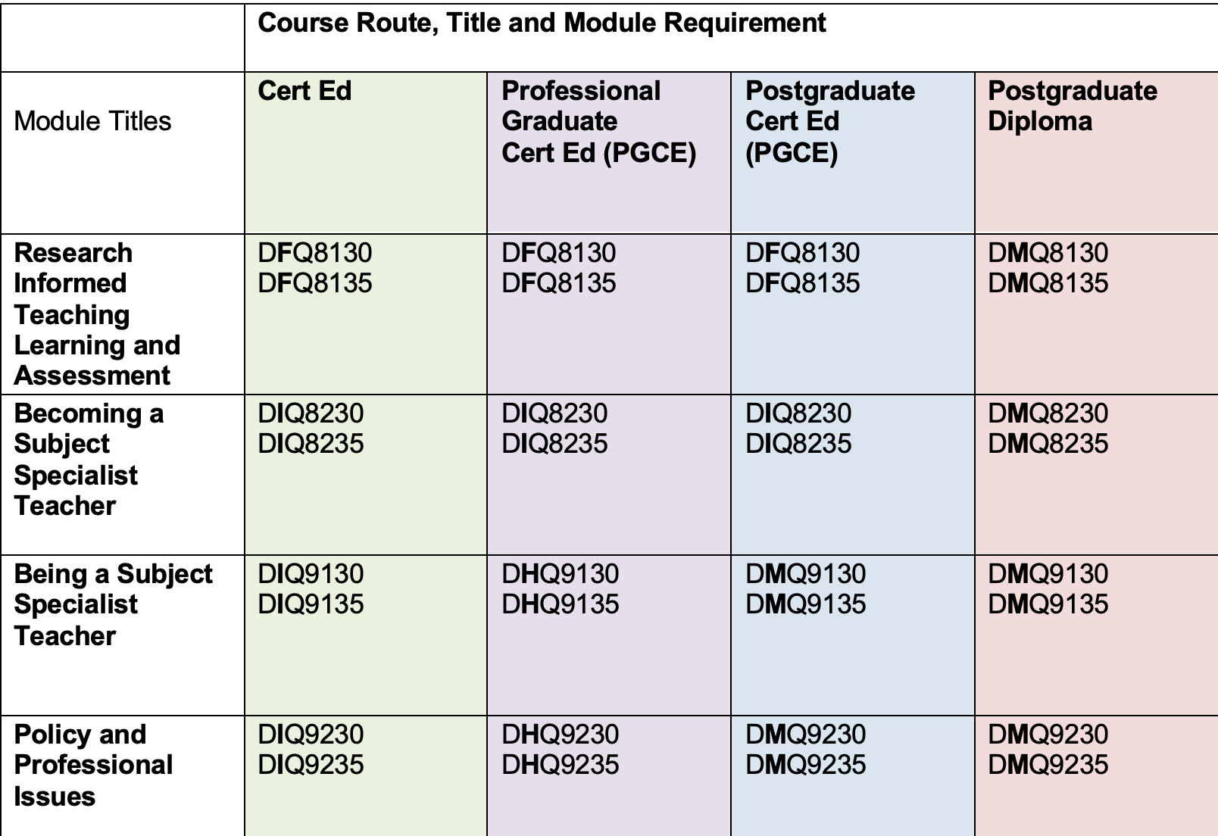
Routes and awards (Year 2 part-time Pre-service and Year 2 In-service)
Level 5
Level 6
Level 7
Level 7
Level 7

Slide 10
Routes and awards (full-time Pre-service, Year 1 part-time Pre-service and Year 1 In-service)
Module Titles | Cert Ed Level 5 | Professional Graduate Cert Ed (PGCE) Level 6 | Postgraduate Cert Ed (PGCE) | Postgraduate Diploma Level 7
Research Informed Teaching Learning and Assessment | DFQ8130 DFQ8135 | DFQ8130 DFQ8135 | DFQ8130 DFQ8135 | DMQ8130 DMQ8135
Becoming a Subject Specialist Teacher | DIQ8230 DIQ8235 | DIQ8230 DIQ8235 | DIQ8230 DIQ8235 | DMQ8230 DMQ8235
Being a Subject Specialist Teacher | DIQ9130 DIQ9135 | DHQ9130 DHQ9135 | DMQ9130 DMQ9135 Level /7 | DMQ9130 DMQ9135
Curriculum and Context (or option module) | DIQ1330 / DIQ1335 | DHQ1330 / DHQ1335 | DMQ1330 / DMQ1335 Level /7 | DMQ1330 / DMQ1335

Slide 11
The trainees
Typically, are well-qualified in their specialist subject area.
Often have relevant experience of working in their specialist field.
They may have limited experience of teaching, although some may have been teaching or training for a considerable amount of time.

Slide 12
Aims of the teaching practice
Provides the opportunity for trainees to achieve many of the outcomes for the course.
Trainees:
acquire guided experience in the teaching their own specialism
develop professional skills and techniques associated with the teaching role
develop expertise in performing the teacher's role both in the classroom and the wider context
acquire personal experience of the structure, organisation and work of the setting in its broadest sense
involve themselves in effective working relationships with staff in the setting.

Slide 13
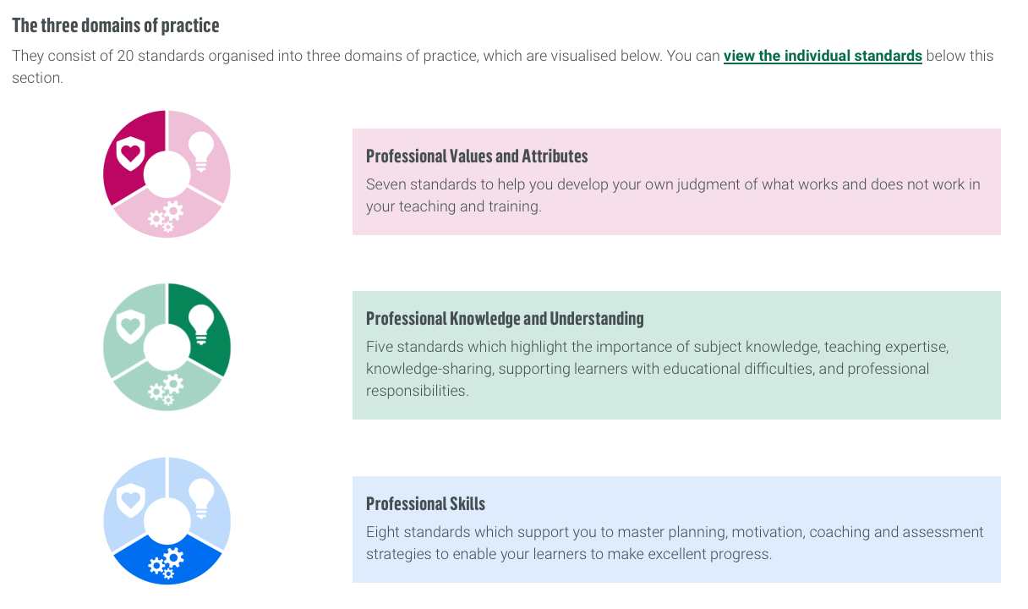
Expectations of trainees – Year 2 part-time Pre-service and Year 2 In-service trainees
Work towards the Education and Training Foundation (ETF)
Professional Standards for Teachers and Trainers (2022)
at https://www.et-foundation.co.uk/professional-standards/teachers/
Our trainees’ progress and development is mapped against these standards.
Trainees:
Develop their awareness and understanding of the setting, context and organisation.
Participate in a full teaching role plus other duties and responsibilities associated with this.
Demonstrate a professional attitude.
Seek out and be receptive to feedback and support.
Prepare, maintain and evaluate schemes of work, lesson plans and assessment records.
Demonstrate a commitment to reflect, evaluate and develop their own performance.

Slide 14
Expectations of trainees – full-time Pre-service, Year 1 part-time Pre-service and Year 1 In-service trainees
Work towards the Learning and Skills Teacher Occupational Standard
Learning and skills teacher / Institute for Apprenticeships and Technical Education
Our trainees’ progress and development is mapped against this standard.
Trainees:
Develop their awareness and understanding of the setting, context and organisation.
Participate in a full teaching role plus other duties and responsibilities associated with this.
Demonstrate a professional attitude.
Seek out and be receptive to feedback and support.
Prepare, maintain and evaluate schemes of work, lesson plans and assessment records.
Demonstrate a commitment to reflect, evaluate and develop their own performance.

Slide 15
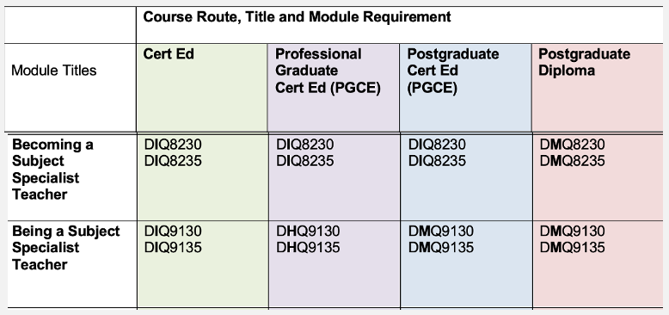
Practical modules
Trainees complete 4 modules in total on the course.
Two of these modules relate directly to their teaching practice.

Slide 16
Standard requirements for assessment of practical teaching
A minimum of 250 hours workplace or placement attendance, of which 150 should be teaching.
75 hours for each of the two teaching practice modules.
10 teaching observations (5 observations in each teaching practice module).
50 hours wider experience (e.g. teaching observations, attendance at meetings, open days, moderation and standardisation, curriculum development activities etc.)
A personal development e-portfolio.
Evidence of planning, resources and reflection relating to teaching in each of the two teaching practice modules.

Slide 17
Teaching practice
Teaching: whole classes, team teaching, small groups, one to one, distance and online.
Where appropriate, trainees should be phased in, taking on increasing responsibility for planning and delivery.
Experience of a range of groups, courses, levels, and settings within their subject area.
Opportunities to observe other teachers.
Trainees will also be expected to help learners develop their maths, English and digital skills.

Slide 18
In addition, trainees should be encouraged to ……..
Become involved with the department.
Discuss their progress with their mentor.
Identify points for development following observations.
Attend events such as course team meetings and staff development as appropriate.
Attend open evenings, interviews and other civic duties.
Supervised visits and extra-curricular activities.
Pre-service trainees should not receive payment for their teaching on placement.

Slide 19
Role of mentors
The mentor would normally :
Be a suitably qualified and experienced teacher.
Be a critical friend - Identify any issues with progress - Provide the link with the University.
The mentor can assist the trainee in the following areas:
Induct the trainee into the specialist department and wider setting.
Supervise planning at the lesson and course level.
Provide access to unit specifications and resources.
Conduct teaching observations which includes constructive feedback on practice, especially relating to subject specialist pedagogy.
Carry out progress reviews.
Agree action plans and interventions to enable the trainee to work towards the requirements of the ETF Professional Standards (year 2 part-time trainees) or the Learning and Skills Teacher Occupational Standard (full-time Pre-service and year 1 part-time trainees).

Slide 20
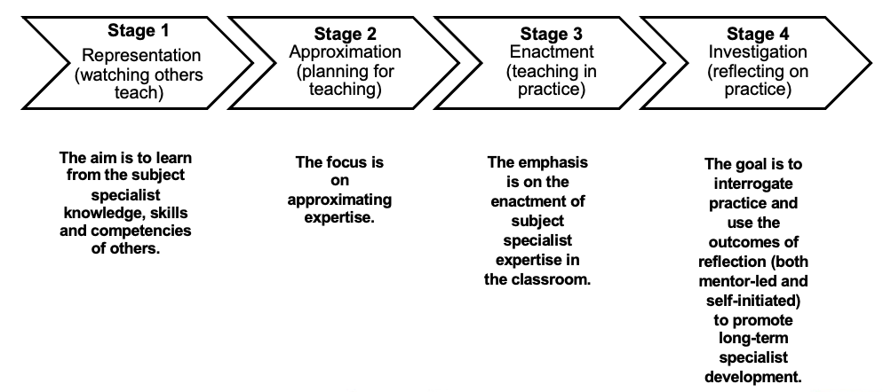
The 4-stage typology of trainee development
Adapted from: McDonald, M., Kazemi, E., & Kavanagh, S. (2013). Core Practices and Pedagogies of Teacher Education: A Call for a Common Language and Collective Activity. Journal of Teacher Education, 64(5), 378–386, p.382.

Slide 21
Four-stage representation of mentor support: stage 1 - representation
Aim is to learn from the subject specialist knowledge, skills and competencies of others.
You can do this by:
Helping the mentee to understand the distinction between subject knowledge and subject pedagogy at an early stage.
Increasing opportunities for mentees to observe subject- specialist delivery in practice.
Encouraging the mentee to identify practices associated with SPK in specialist teaching sessions.
Sharing specialist resources with mentees and encouraging critique.
Building on centre-based ITE curriculum activities, linking generic theory to subject specialist content and knowledge.
Module: Becoming a Subject Specialist Teacher
ITT Mentor Standards (2016) All elements of Standard 1; 2.5, 2.6
and 2.9 and all elements of Standard 3.

Slide 22
Stage 2: approximation
The focus is on approximating expertise.
You can do this by:
Introducing the mentee to the scope and variety of subject-specialist classroom practices (both virtual and in-person).
Modelling learning design that is informed by SPK principles.
Encouraging your mentee to practise using subject-specialist pedagogical approaches.
Helping your mentee to identify the areas of specialist practice that they need to work on.
Interweaving the specialist discourse of your subject into professional discussions with your mentee.
Maximizing the mentee’s engagement with subject-specialist theory and pedagogical practice (including simulated).
Providing mentees with opportunities to practise what they have learned from their course modules.
Module: Becoming a Subject Specialist Teacher
ITT Mentor Standards (2016) All elements of Standard 1; 2.2, 2.4, 2.5 and
2.9; and all elements of Standard 3.

Slide 23
Stage 3: enactment
The emphasis is on the enactment of subject specialist expertise in the classroom.
You can do this by:
Linking SPK practices to authentic workplace experiences (largely applicable to VET classrooms).
Increasing your mentee’s exposure to a range of specialist curricula.
Formatively assessing the enactment of subject specialist expertise in the classroom.
Communicating the progress of your mentee in subject specialist terms and applying measures of SPK to verbal and written feedback on your mentee’s practice.
Identifying gaps in the mentee’s SPK competencies and skills and providing opportunities to bridge these.
Integrating subject-specific literature and evidence-informed research into written and verbal feedback.
Providing details of subject specialist professional development that the mentee can undertake within the placement setting.
Module: Being a Subject Specialist Teacher
ITT Mentor Standards (2016) All elements of Standards 1, 2 and 3.

Slide 24
Stage 4: investigation
The goal is to interrogate practice and use the outcomes of reflection (both mentor-led and self-initiated) to promote long-term specialist development.
You can do this by:
Supporting the mentee’s subject-specific reflections on practice.
Encouraging the mentee to evaluate the reliability of subject-specialist teaching methods.
Stimulating critical reflection on pedagogical values in observation feedback.
Using the signature pedagogies framework to structure reflective discussion with your mentee.
Signposting your mentee to professional development focused on SPK and specialist curriculum materials.
Highlighting opportunities to engage in practitioner-based research in the specialist field.
Module: Being a Subject Specialist Teacher
ITT Mentor Standards (2016) All elements of Standard 1; 2.6 and 2; all elements of Standard 3; all elements of Standard 4.

Slide 25
Ways of mentoring
Meet on a regular basis
Get to know each other
Share expertise
Communicate
Support
Challenge constructively
Observe
Provide verbal and written feedback with action points

Slide 26
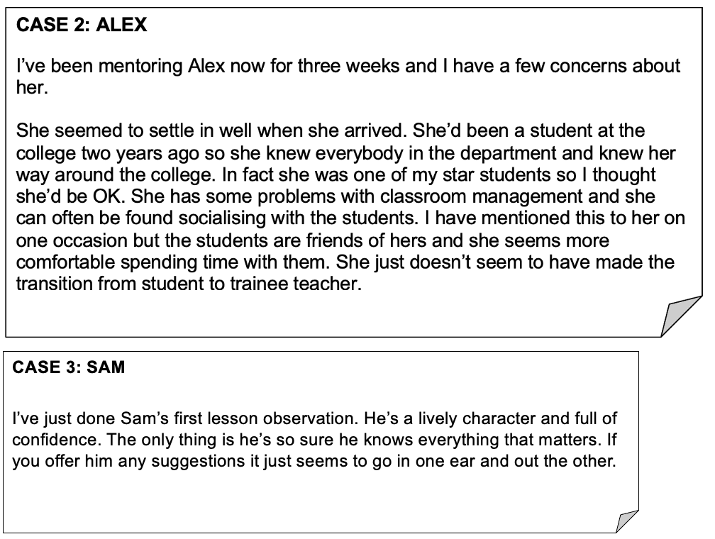
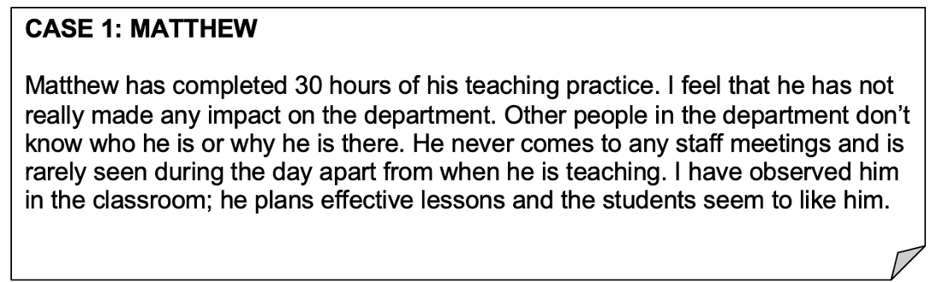
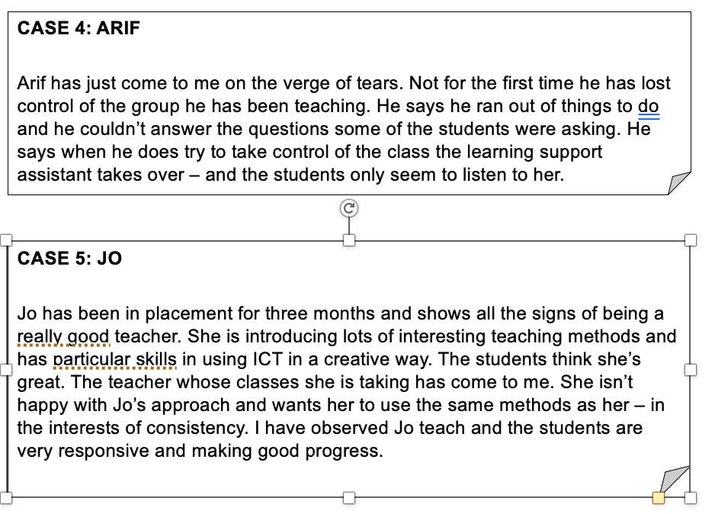
Mentoring case studies
What action might you take in each situation?
What further information might you need?
Who might you go to for support and advice?

Slide 27
Observation of trainees
Constructive and developmental feedback taking account of the stage.
Not graded.
Joint observations with a University tutor will be arranged for QA purposes.

Slide 28
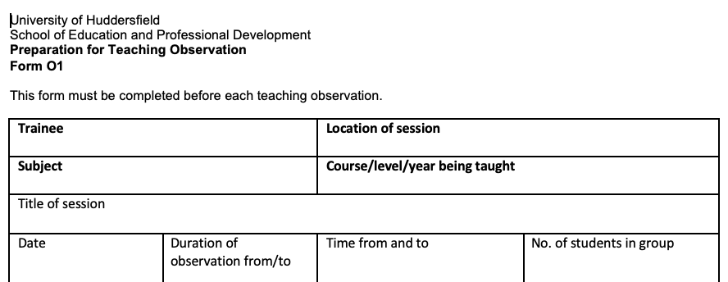
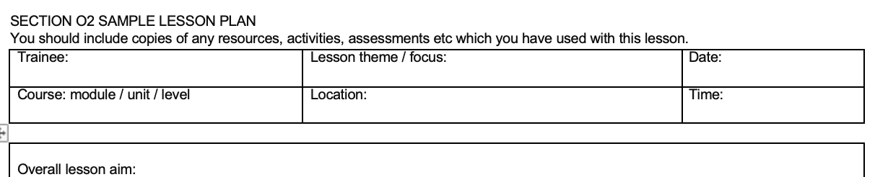
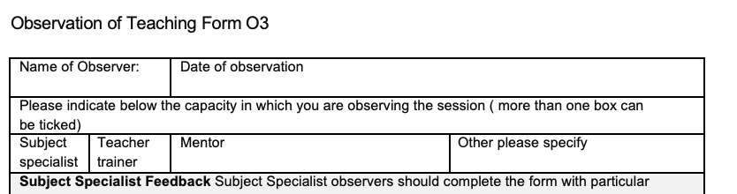
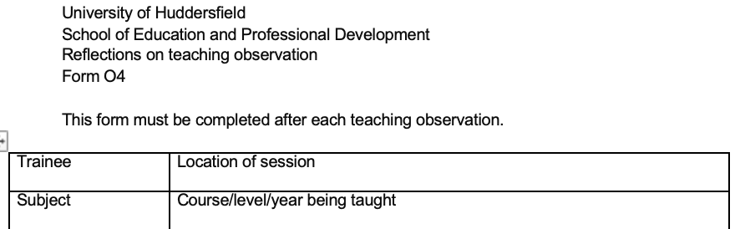
Observations and assessments (Year 2 part-time Pre-service and Year 2 In-service trainees)
O1: Lesson Preparation form.
Trainee Completes
O2: (lesson plan and any supporting resources for the session).
Trainee Completes
O3: Observation of Teaching.
Mentor Completes
O4: Reflections on Teaching Observation form.
Trainee Completes

Slide 29
Observations and assessments (full-time Pre-service, Year 1 part-time Pre-service and Year In-service trainees)
  Observation planning document (incorporating a rationale and lesson plan)
  Trainee Completes
  Observer feedback form
  Mentor Completes
  Reflection on teaching observation
  Trainee Completes

Slide 30
Signature pedagogies
“the types of teaching that organize the fundamental ways in which future practitioners are educated for their new professions” (p.52).
“the forms of instruction that leap to mind when we think about the preparation of members of a particular profession” (p.52).
“They implicitly define what counts as knowledge in a field and how things become known” (p.54).
Shulman, L.S. (2005) “Signature Pedagogies in the Professions”, Daedalus, 134(3), pp.52-59.

Slide 31
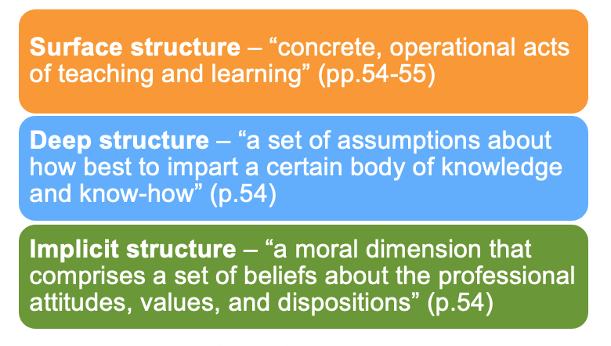
Signature pedagogies

Slide 32
Potential problem areas
Initial planning.
Basic procedures.
Using appropriate and effective language.
Evaluating and assessing performance.
Integrating with other staff.

Slide 33
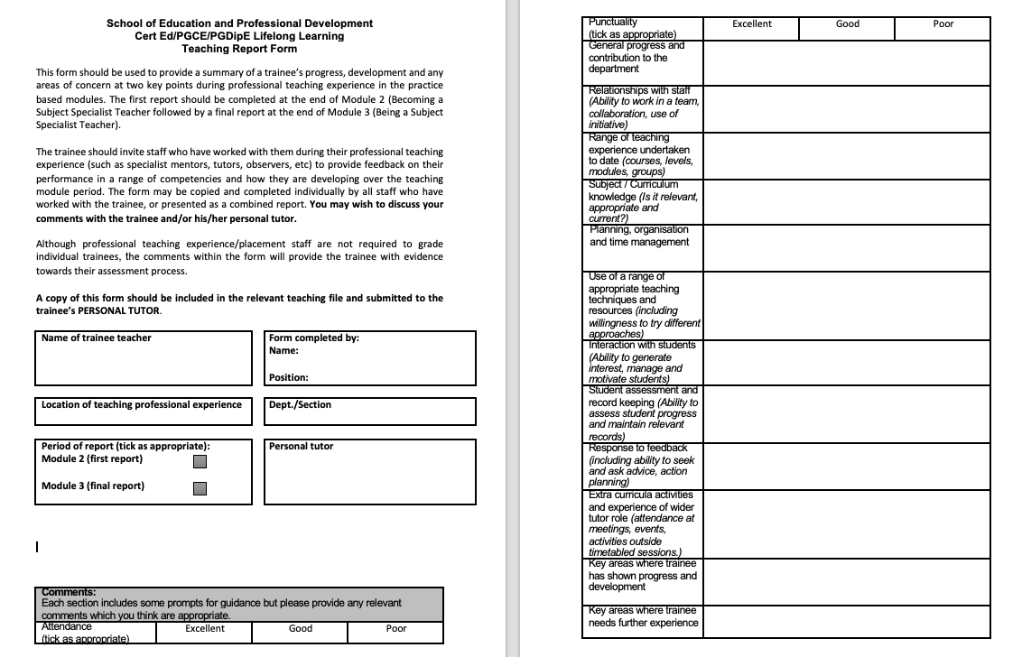
Documentation: Personal Development Plan (PDP)
Trainees are expected to maintain a digital teaching file in each of the two teaching practice modules and an ongoing log of teaching hours (75 hours per practical module) with:
Teaching observation reports (a minimum of five per module).
Mentor discussions, particularly subject specialist issues.
Documentation.
Teaching Report Form. Mentor completes.

Slide 34
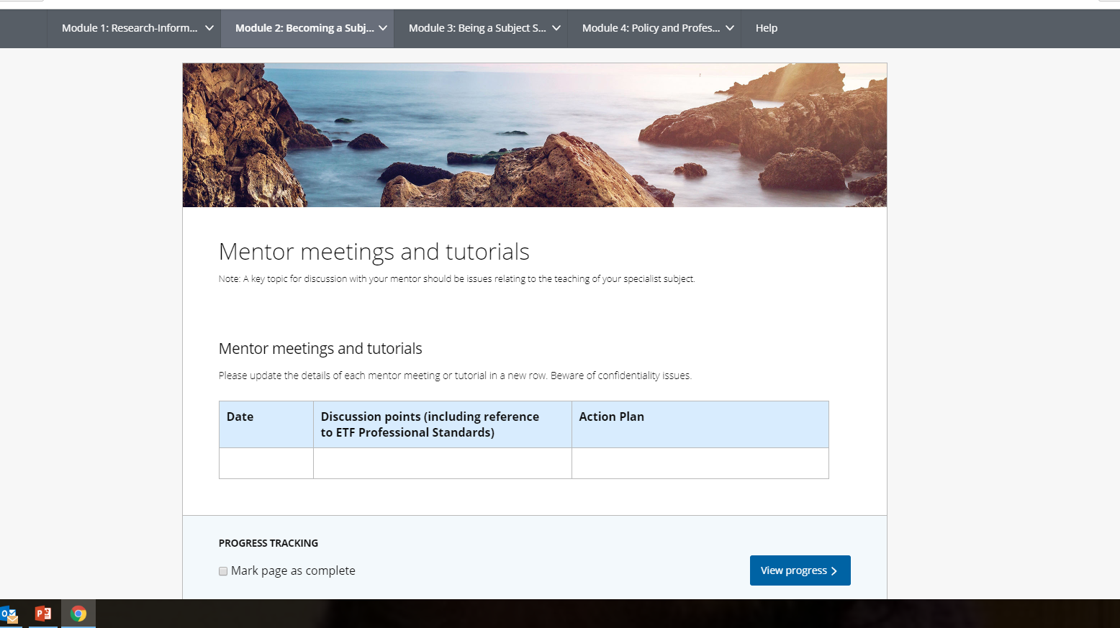
E-portfolio (Pebblepad)

Slide 35
OfSTED Inspections of Initial Teacher Training
Short notice inspections.
Significant focus on mentors, trainees and former trainees.
Visits and observations to centres.
Talking to mentors, trainees and former trainees.
Employment information about former trainees.
Documentation.
Quality assurance.
Partnerships with the University.

Slide 36
And finally…
Please ensure you maintain close links with your trainee, the University, or partner organisation.
Make known any concerns you have about a trainee.
Let us know of any changes to mentoring arrangements.
Complete joint observations with the University tutor.
Thank you for attending and for supporting our trainees.
Our mission is:
To develop professional educators whose purpose is to transform the learning and life opportunities of the children, young people and adults with whom they work. Through inclusive practice, reflection and commitment to continuous personal development, our trainees are empowered to become autonomous practitioners who enable all learners to realise their potential.

Slide 37


Further Resources
Books:
Malderez, A. (2023) Mentoring Teachers: Supporting Learning, Wellbeing and Retention. Routledge.
Mentoring resources – Huddersfield
Subject Specialist Pedagogy

