Slide 1
Secondary ITE Partnership
PGCE Secondary Curriculum
School of Education and Professional Development
sepd@hud.ac.uk
Social Media: @eduhuduni
#TeachHud

Slide 2
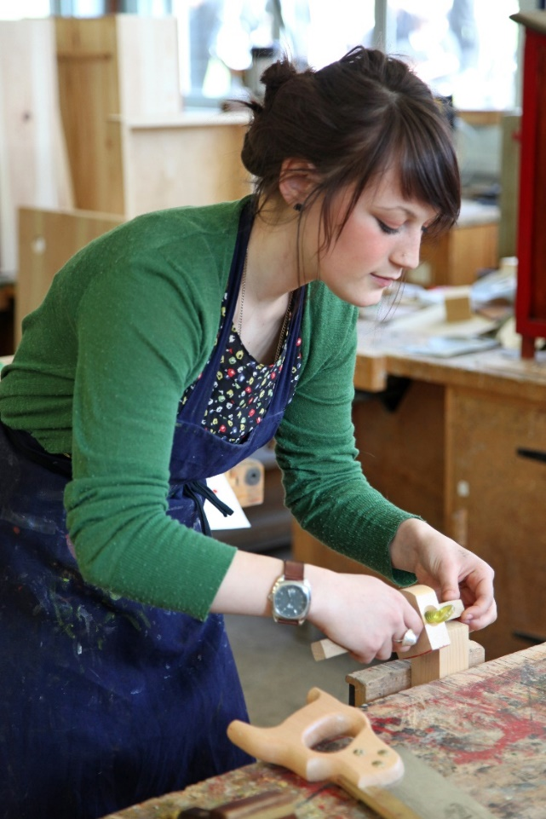
Our values
Our Values
Empowering partnerships
Commitment to developing our knowledge and expertise
Providing personalised support for trainees and mentors
Transformative learning experiences for trainees and pupils
Inclusion and social justice

Slide 3
Mission Statement
Our Mission
Our Initial Teacher Education programmes develop professional educators whose purpose is to transform the learning and life opportunities of the children, young people and adults with whom they work.
Through inclusive practice, reflection and commitment to continuous personal development our trainees are empowered to become autonomous practitioners who enable all learners to realise their potential.

Slide 4
Our Aims
To develop teachers who:
Have a holistic understanding of the role of a teacher both within and beyond the classroom, and a strong moral purpose for teaching
Use inclusive teaching techniques and philosophies
Use evidence based pedagogy
Have strong subject & curriculum knowledge and see their professional learning as a continuous journey beyond their training year
Apply reflective and critical thinking to their teaching
Are effective and engaging practitioners
Become autonomous, confident professionals who are able to make informed decisions in partnership with other stakeholders

Slide 5
ITE Curriculum Intent
Create supportive environments
Curriculum expertise
Evidence informed pedagogies
Professional accountability
Focus and articulate high expectations for all learners
How to develop a positive climate for learning through proactive behaviour management
Teaching that is underpinned by care, empathy & respect
Responsibility to ensure the safeguarding of children and young people
Secure subject knowledge
Developing pedagogical content knowledge
Command of subject specific pedagogy
Understanding of curriculum design and development
Models of progression & age related expectations
Effective assessment practice
How children, young people & adults learn
Planning that builds on prior knowledge & gradually increases challenge
Teaching strategies that transform learners’ knowledge, skills and progress
Adaptive practice that enables all learners to succeed
Evaluate the impact of teaching on students’ learning
Embrace the wider role of a teacher and develop effective professional relationships with colleagues
Develop sustainable, critically reflective practice
Value continuing professional development
Justify and make informed decisions
Commitment to inclusive practice and social justice
‘Becoming’ ‘Being‘

Slide 6
Behaviour
Transitions
Starting a Lesson
Ending a Lesson
Handling question & response
Health and safety
Expectations
Fostering positive relationships
Using student names
Follow-up
Involving stakeholders
Consistency across all students
Understanding students and their attainment data
Handling misbehaviour
De-escalation strategies
Positive reinforcement
Sanction and reward policies
Respectful and proportionate discipline
Effective motivational strategies
Our behaviour training aligns with the 3R’s model proposed by Tom Bennett and incorporates strategies promoted by practitioners such as Bill Rogers.
Further Reading:
Developing behaviour management content for initial teacher training (2016)
by Tom Bennett
Classroom Behaviour (2015)
by Bill Rogers

Slide 7
How Pupils Learn
Retrieval practice
Spaced practice
Dual Coding
Interleaving
Concrete examples
Cognitive Load
We align our training with learning theories and memorisation strategies encouraged by researchers such as Robert and Elizabeth Bjork
Further Reading:
https://www.learningscientists.org/
https://bjorklab.psych.ucla.edu/research/

Slide 8
Inclusive Practice
Inclusive Education
Teaching all Students
Promoting Social Justice
Exploring Multiple Identities
Preventing Prejudice
Choosing Appropriate Materials
Teaching about Cultures and Religions
Adapting and Integrating Lessons Appropriately
Our training around inclusive practice is principled around Tanenbaum’s seven principles of inclusive education
Further Reading:
https://tanenbaum.org/wp-content/uploads/2016/06/ED-Seven-Principles-NEW.pdf

Slide 9
Lesson Planning
Where are they now?
Where are we going?
How do I get them there?
What tasks (and task variance) demonstrate acquisition of that knowledge/ability?
How do I assess them?
What likely misconceptions are there going to be?
Exposition | Modelling
| Scaffold
| Sequencing

Slide 10
Assessment
Individual assessment
Whole class assessment opportunities
Assess Prerequisite Knowledge
Corrective Teaching
Effective Task Design
Feedback and corrective opportunities
Peer assessment
Our training around assessment utilises strategies and underpinning ideas promoted by researchers such as Dylan Wiliam and Daisy Christodoulou
Further Reading:
Embedded Formative Assessment (2017)
by Dylan Wiliam
Making Good Progress? (2017)
by Daisy Christodoulou
Self assessment

Slide 11
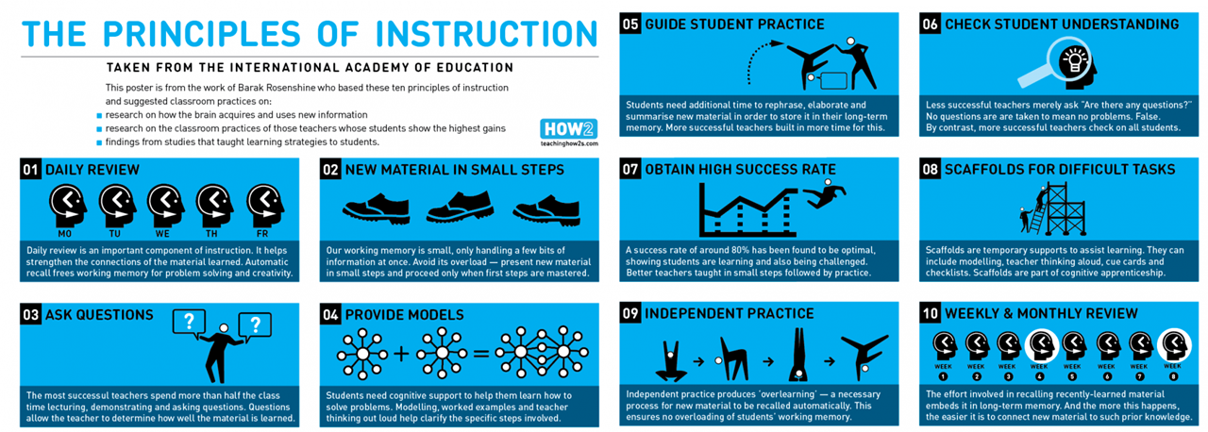
Pedagogy
Our training around general pedagogy promotes strategies and underpinning ideas highlighted by researchers such as Barak Rosenshine and Doug Lemov
Further Reading:
https://www.aft.org/sites/default/files/periodicals/Rosenshine.pdf
Teach Like a Champion 2.0 (2015)
by Doug Lemov

Slide 12
Assessment Flowchart
Mentor fills in report and trainee uploads it to Pebblepad
Trainee gathers evidence bundle and uploads to Pebblepad
Tutor checks evidence bundle and report and plans questions for viva
Trainee meets tutor for viva and discussion of targets
Trainee fills in targets on PP and tutor verifies judgement outcome on Pebblpad
Trainee prepares for the mentor meeting by reflecting on progress and ensuring Pebblepad is up to date
Mentor and trainee discuss progress against assessment criteria
Professional Values and Practice Module Outcomes:
Pass
Resit

